Slide 1
Scikit-learn
Francesco Bellotti, Univ. Genova

Slide 2
Scikit-learn
Tutorial to into the data and classification algorithms
Explore (plot) data
Preprocess and Training_testing_set
Transform categorical columns into numeric, select columns
3 algorithm examples (NB, Linear SVC, k-nn)
Classification report
2 further examples

Slide 3
1_Countplot
Use seaborne package
Countplot()
Plot histograms of 1, 2 categorical variables
Catplot()
Plot also third category
https://seaborn.pydata.org/generated/seaborn.countplot.html

Slide 4
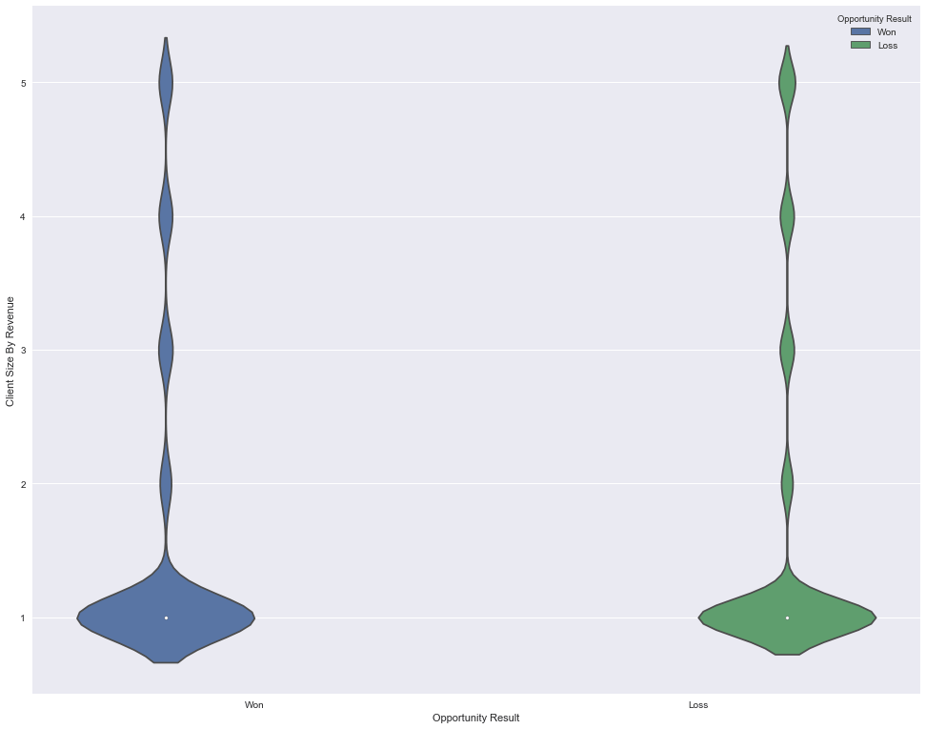
2_explore_data
Use seaborne package
Countplot()
Violinplot()
https://www.dataquest.io/blog/sci-kit-learn-tutorial/

Slide 5
Preprocess
Input file for all algorithms: win loss of a marketing campaign
sklearn.preprocessing.LabelEncoder to convert the categorical columns into numeric
Fit_transform()
uinque() on a dataframe column
https://www.dataquest.io/blog/sci-kit-learn-tutorial/

Slide 6
Training_testing_set
Select data columns by removing others
Select target column
from sklearn.model_selection import train_test_split

Slide 7
K-nn
Intuition of the algorithm
Construction with hyperparameter (k)
fit() on the training set
predict() on the testing set
accuracy_score
Classification_report() in figure with yellowbrick

Slide 8
SVM
Intuition of the algorithm
https://blog.statsbot.co/support-vector-machines-tutorial-c1618e635e93
Same as before
Notes:
C as a tradeoff between having a wide margin and having few errors in training data (small C => large tolerance) - Prevent overfitting
Plane in 3D, projected back to 2D becomes a hyperbola
Generalization, kernel

Slide 9
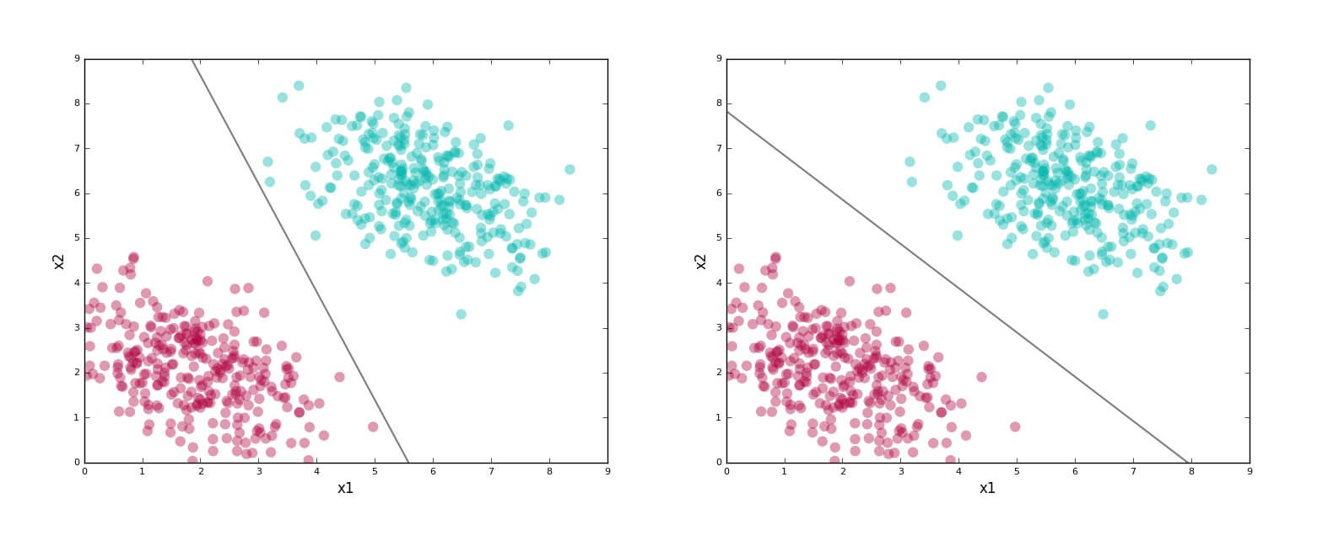
Separating boundary

Slide 10
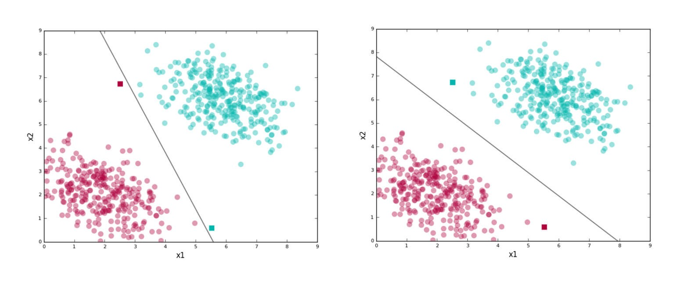
Good vs Bad classifier
On the testing set, not training set.
Generalization is needed

Slide 11
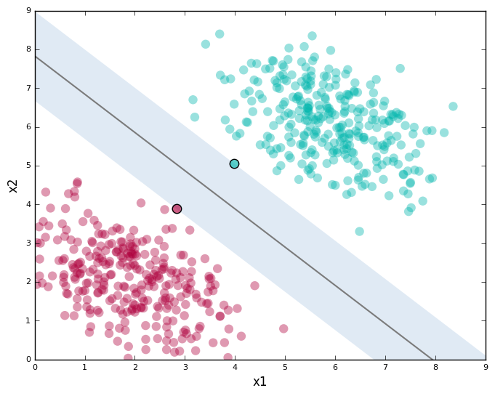
Support vectors
While the plot shows a line and data in two dimensions, it must be noted that SVMs work in any number of dimensions; and in these dimensions, they find the analogue of the two-dimensional line.
Plane
Hyperplane
Linear classifier

Slide 12
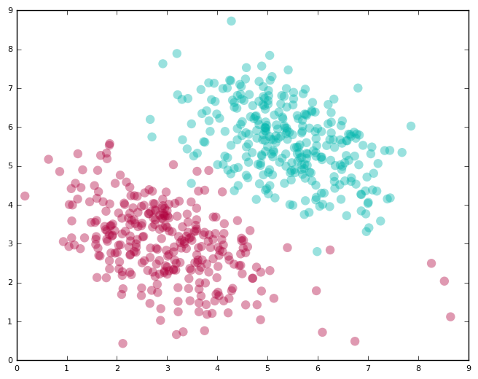
Allowing for errors
A linear classifier cannot perform 100%
You can provide a parameter called “C”; this allows you to dictate the tradeoff between:
Having a wide margin.
Correctly classifying training data.
A higher value of C implies you want lesser errors on the training data.

Slide 13
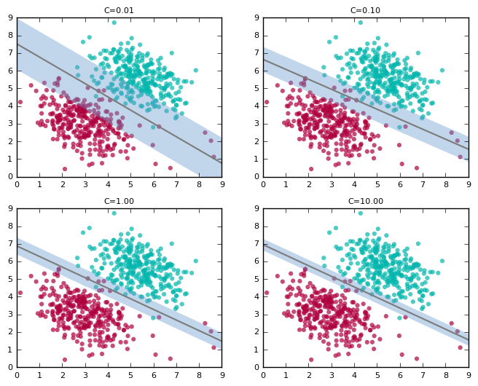
C parameter

Slide 14
Choosing C
Note how the line “tilts” as we increase the value of C. At high values, it tries to accommodate the labels of most of the red points present at the bottom right of the plots. This is probably not what we want for test data.
The first plot with C=0.01 seems to capture the general trend better, although it suffers from a lower accuracy on the training data compared to higher values for C.
An important practical problem is to decide on a good value of C. Since real-world data is almost never cleanly separable, this need comes up often. We typically use a technique like cross-validation to pick a good value for C.

Slide 15
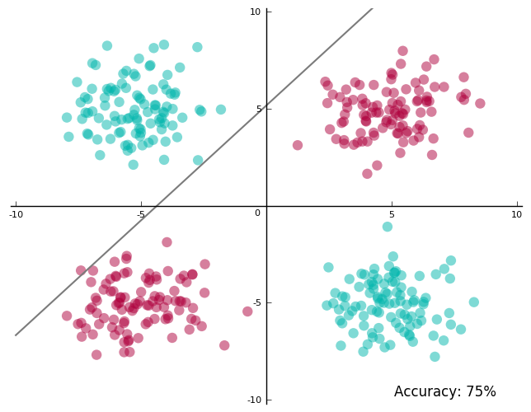
Non-linearly Separable Data

Slide 16
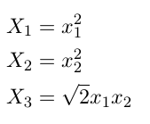

Slide 17
SVM plan

Slide 18
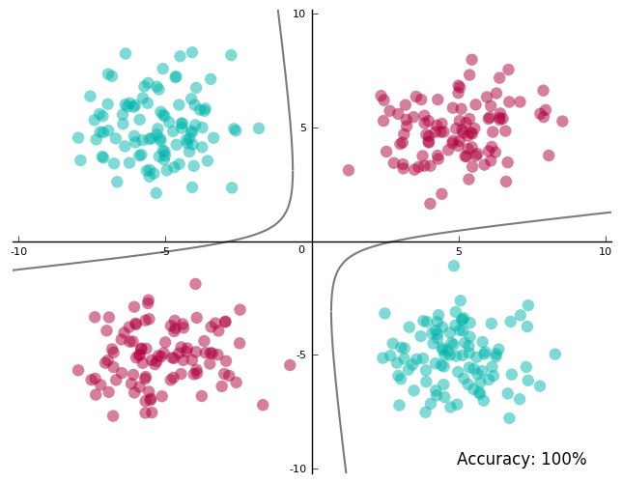
Project the plane to 2D

Slide 20
We know that data is more likely to be linearly separable when projected onto higher dimensions, thanks to Cover’s theorem.
The theorem states that given a set of training data that is not linearly separable, one can with high probability transform it into a training set that is linearly separable by projecting it into a higher-dimensional space via some non-linear transformation.

Slide 21
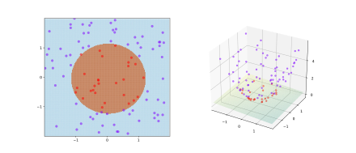

Slide 22
For linearly separable data SVMs work amazingly well.
For data that’s almost linearly separable, SVMs can still be made to work pretty well by using the right value of C.
For data that’s not linearly separable, we can project data to a space where it is perfectly/almost linearly separable, which reduces the problem to 1 or 2 and we are back in business.
Kernels do the projection to high dimensions
Radial Basis Functions kernels can project points to infinite dimensions

Slide 23
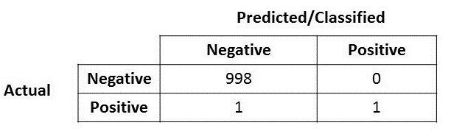
Naive Bayes
We’ll see better the algorithm later.
Now focus only in classification report
https://towardsdatascience.com/accuracy-precision-recall-or-f1-331fb37c5cb9
Confusion matrix
Accuracy

Slide 24
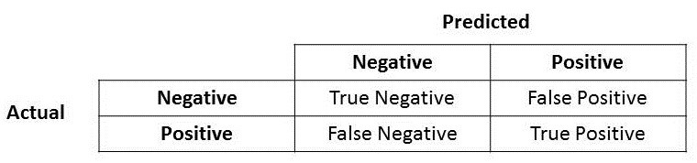
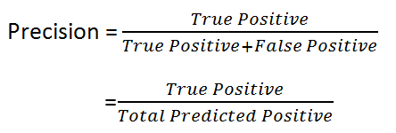
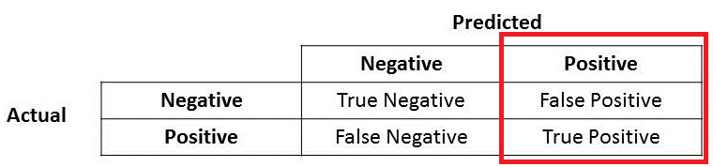
Precision
Precision important when false positive important: e.g., spam detection

Slide 25
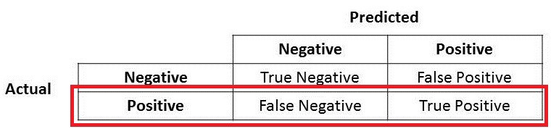
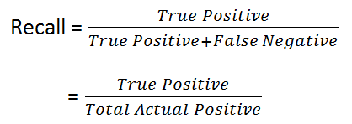
Recall
Recall important when false negative important: e.g., fraud, assassin

Slide 26
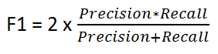
F1 score
F1 Score might be a better measure to use if we need to seek a balance between Precision and Recall AND there is an uneven class distribution (large number of Actual Negatives)

Slide 27
8_iris_digit_tutorial
https://scikit-learn.org/stable/tutorial/basic/tutorial.html
Training, testing with predict()
Model persistence with pickle
Reduce dimensionality through Gaussian random projection
Type casting
Target a categorical variable (not numeric)
Model refitting (e.g., with different SVM kernels)
Multiclass
OneVsRestClassifier () vs Linear vs non linear svm (default: Radial Basis Function)

Slide 28
9_digit_example
https://scikit-learn.org/stable/auto_examples/classification/plot_digits_classification.html#sphx-glr-auto-examples-classification-plot-digits-classification-py

